Slide 1
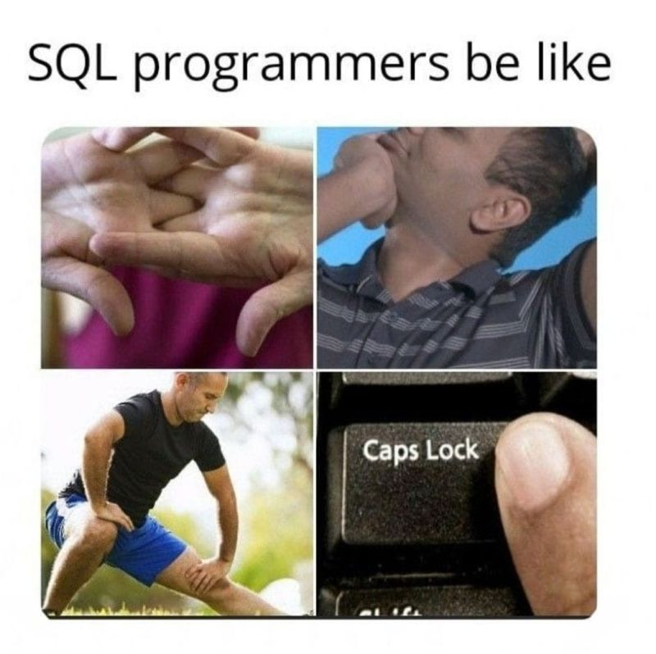
Introduction to SQL workshop
Informal workshop
Kick-start self-study
We are no pros
SQL is easy!

Slide 2
Don’t listen to us, we know nothing
Find resources below, that do a much better job at teaching:
W3schools (free)
Codecademy
DataCamp
Coursera
YouTube!!
Freecodecamp
Luke Barousse

Slide 3
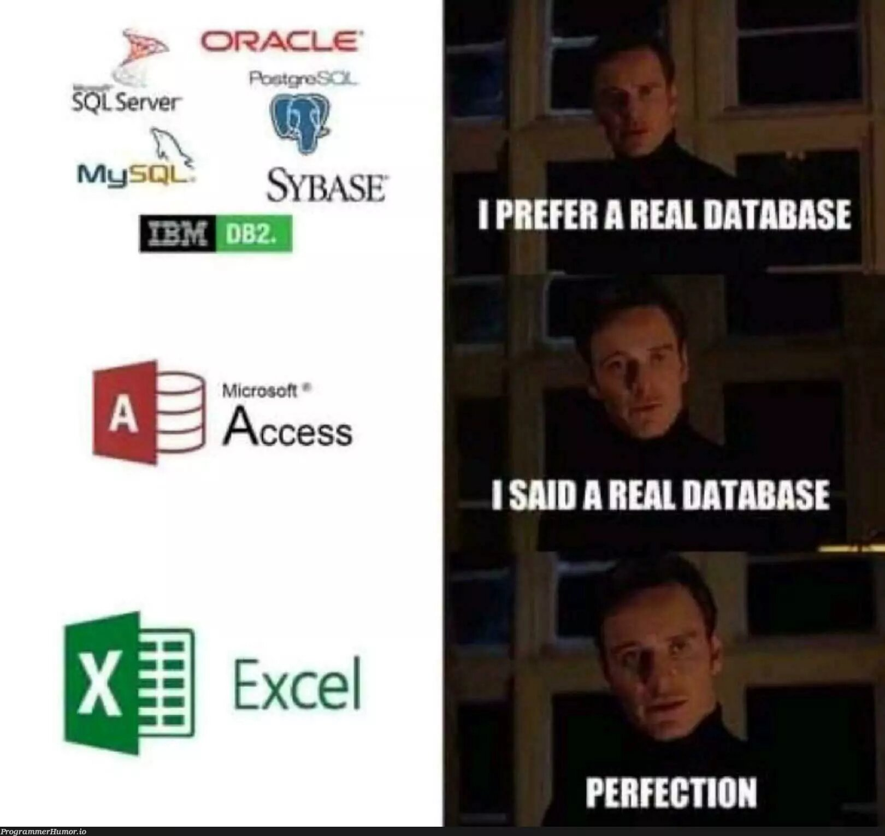
What is SQL ??
And why is it featured in every single job ad?
SQL = Structured Query Language
The benchmark language for accessing and interacting with databases
Used in many different database management systems such as MySQL, PostreSQL, MicrosoftSQLServer, SQLite etc.

Slide 4

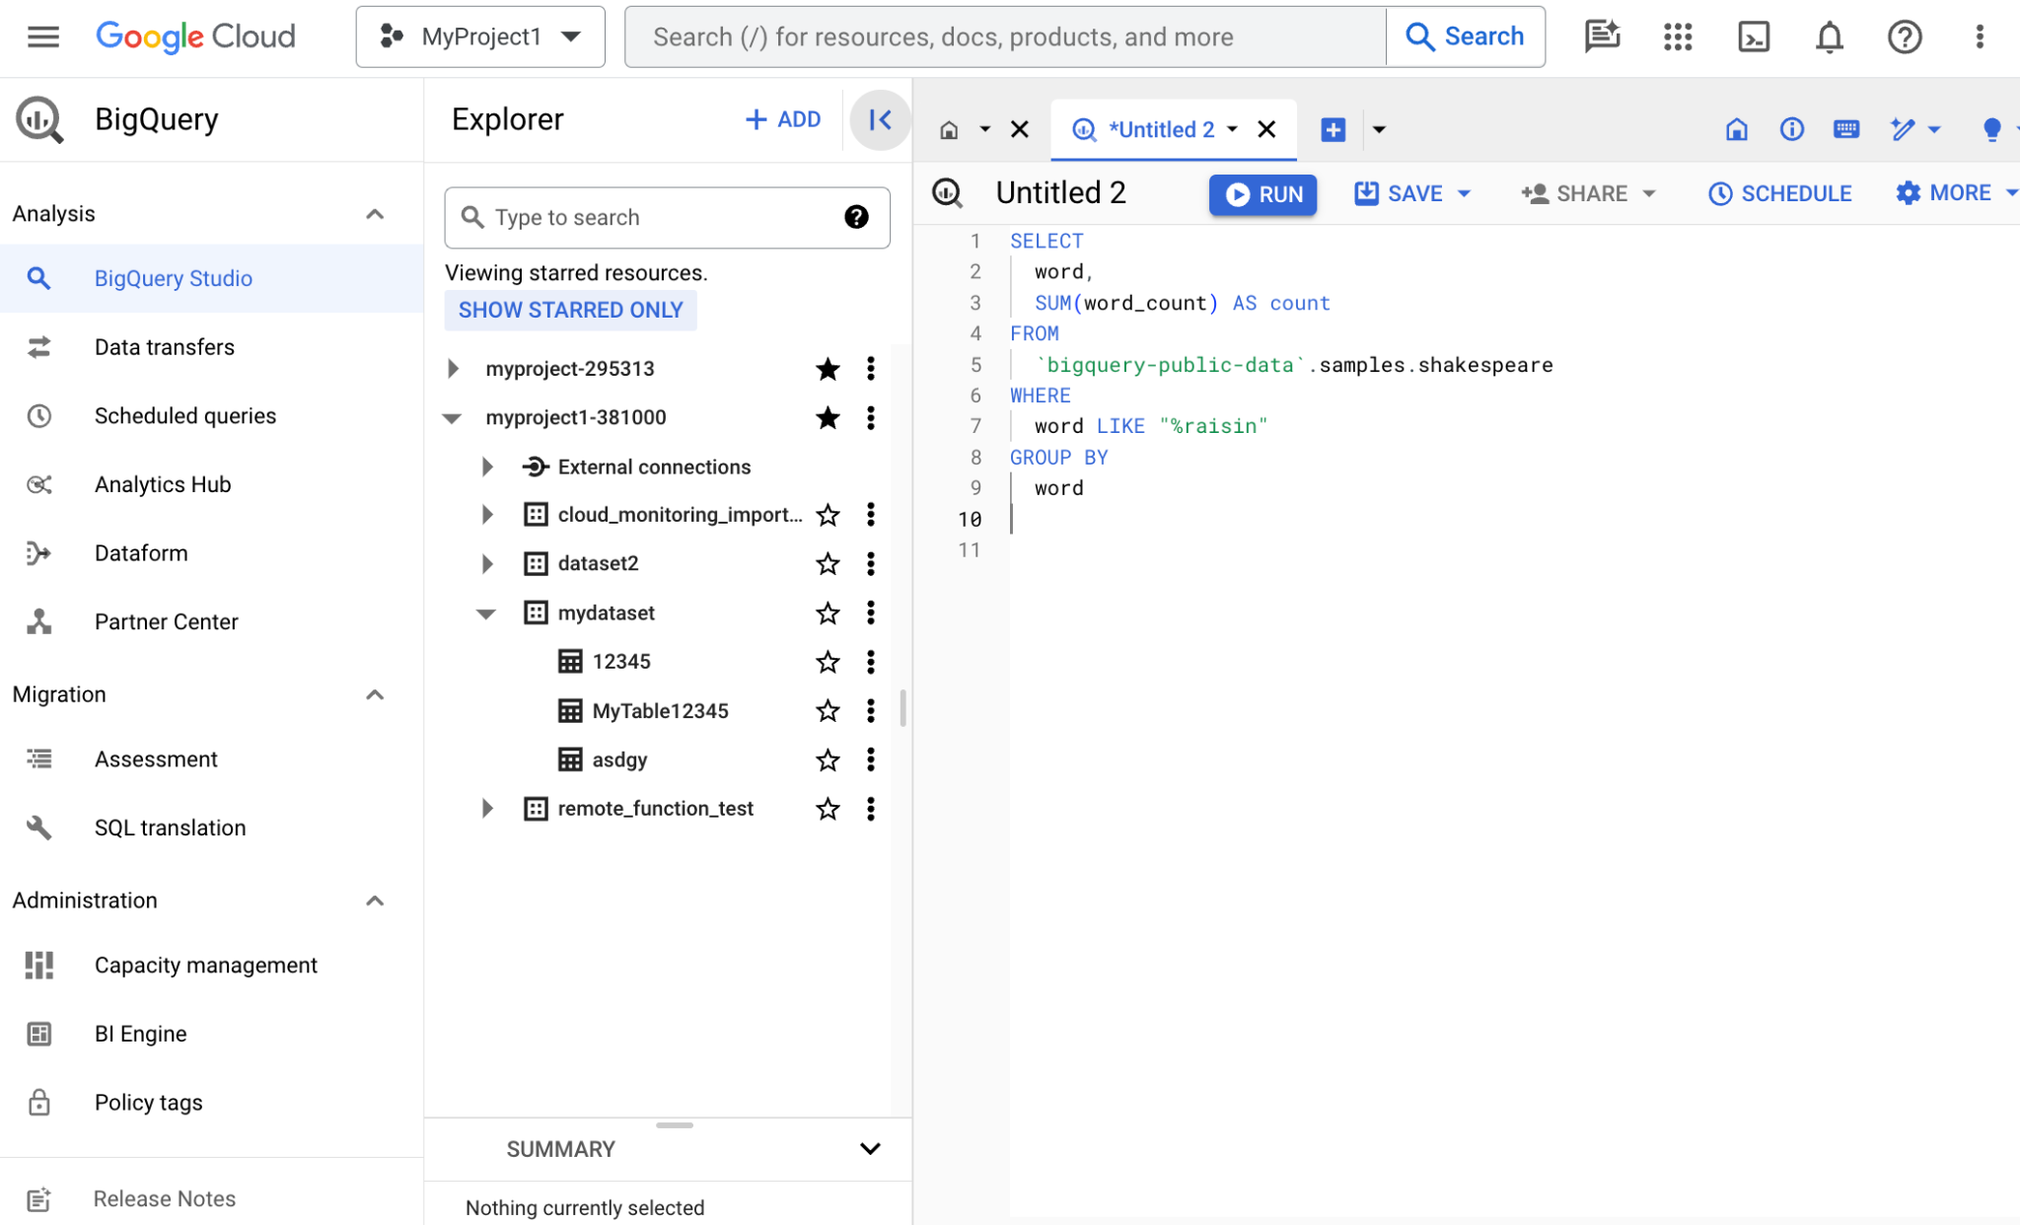
Essentially, a SQL db is a way to store huge amounts of information in a structured way
Organized into tables
Tables hold any information essential to the organization. To be accessed, retrieved, combined

Slide 5
Structure of a SQL Query
Mandatory clauses:
SELECT (which variables)
FROM (which table)
Anything else is essentially “wrapped” within.
SELECT
var1,
var2
FROM
table1
SELECT
*
FROM
table2
SELECT
first_name,
last_name,
employee_id
FROM
employees

Slide 6
Basic Syntax
SELECT
employee_id,
first_name,
last_name
FROM
employees
WHERE
Salary > 4000
WHERE
Filter condition
Limits selected variables to results that satisfy filter condition
Added after FROM
Equality filter
var1 = xyz
Inequality
var2 != > >= xzy
Range
dates
Between “date1” and “date2”
Strings
LIKE ‘S%’
Multiple conditions
AND, OR, NOT, IN()
NULL
WHERE var3 NOT NULL
AND
contract_type = ‘fixed’
AND
employee_id IS NOT NULL

Slide 7
Basic Syntax
SELECT
department_id,
AVG(salary)
FROM
employees
GROUP BY
department_id
GROUP BY
Divides the results into groups, based on one (or more) columns
Departments, counties, cities, etc
Aggregate level results
Changes the “level” of the results
Added after FROM
Mostly used together with aggregate functions
AVG()
SUM()
MAX()
MIN()
COUNT()

Slide 8
Basic Syntax
SELECT
department_id,
AVG(salary)
FROMemployees
GROUP BY
department_id
ORDER BY
department_id DESC
LIMIT 10
ORDER BY
Orders the output of the results, by a specified column
In ascending order by default
Can be specified via variable names or variable index
LIMIT
Simply limits row results to a specified number
Great for getting a first look at the entire table
When running huge SQL scripts, that take too long to run for proof of concepts of bug hunting
Added all the way at the end
Generally, all queries are run in a specific order
from, (join), where, group by, select etc.

Slide 9
Basic SQL syntax exercises
Select all rows from the table
SELECT * FROM epex_12_20_12_13
What is the overall average price of all trades featured in the table?
SELECT AVG(price) FROM epex_12_20_12_13
Which trades show a price greater than 10?
SELECT id, price FROM epex_12_20_12_13 WHERE price > 10
Which trades show a price greater than 13, on the buy side?
SELECT id, price FROM epex_12_20_12_13 WHERE price > 10 AND side = 'buy’
How many trades have a quantity below 15?
SELECT COUNT(id) AS n_below_15 FROM epex_12_20_12_13 WHERE quantity < 15

Slide 10
Basic SQL syntax exercises
What's the average price for trades that follow strategy1?
SELECT AVG(price) FROM epex_12_20_12_13 WHERE strategy = 'strategy_1’
What is the highest price on a trade, on the sell side, with a quantity of over 13? Which one is it?
SELECT id, MAX(price) FROM epex_12_20_12_13 WHERE side = 'sell' AND quantity > 13
Order all trades on the sell side, extracting quantity, price and id, in descending order.
SELECT * FROM epex_12_20_12_13 ORDER BY id DESC

Slide 11
You need to know the syntax, but you probably won’t be asked such straightforward questions!
People will approach you because they need answers to a problem.
It’s up to you to put this into a query!
More realistic prompts could be: (taken from a campaigning perspective)
How many canvass shifts did every organizer recruit for each day of GOTV?
What does this even mean?
List the volunteers who have completed a canvass shift that are currently signed up for a GOTV phone bank shift.
What’s canvass?
How many voters were contacted on day x, for each county?
What are the current state senate race projections? Are we winning?
Which state senators are up for election?
What does ‘winning’ mean in quantitative terms?
Where do I get projections, which ones? Do I need outside information to answer this question?
SQL syntax knowledge alone won’t help here, you need to know the details of the question you are supposed to answer!

Slide 12
Takeaways so far
Syntax knowledge is important, but domain/db knowledge is essential!
What’s the db? Which tables am I drawing from? What’s the meaning of the variables? Where are they? How to combine tables and their information?
Go study SQL and understand the basics, but you learn SQL by applying it!
Stick to best practices to ease code communication, look out for indentation, commas etc.
Consider your audience, when presenting results! Good code is worthless, if the output is not readable for everyone!

Slide 13
Next Steps
Check out the free resources linked at the beginning.
Make sure you understand the basic syntax of select, from, where, group by. These will most probably be feature in EVERY SINGLE query you will end up writing.
Learn joins properly (shoutout Venn diagrams). They are essential and high-impact. It’s not uncommon to have several joins within one query.
Learn Common Table Epressions (CTE) and subqueries. 99% of the queries you will be asked to write, will need several subqueries.
Ask/approach the Hertie School Coding Club, if you have any questions, we’re happy to help out ☺
HAPPY HACKING!!

Slide 14
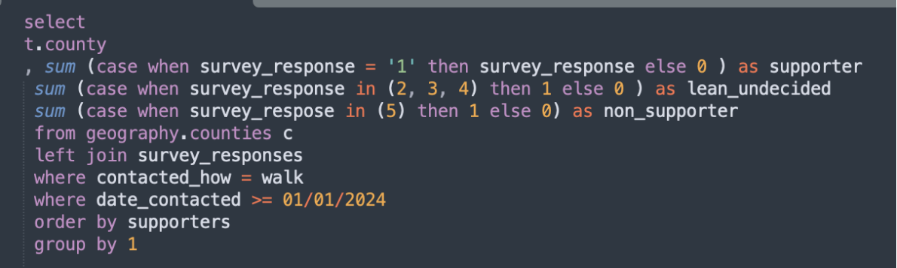
Code Review
Why won’t this query execute?
As Germans would say, this is just a little “Schmankerl”. Try to find as many bugs as possible, but you don’t have to feel like you should be able to find every single one!

